Slide 1

Operating Systems
BCSC 0004
CPU Scheduling
Shortest Job First
(SJF)

Slide 2
Shortest Job Next (SJN)/Shortest Job First
This is also known as shortest job first, or SJF
This is a non-preemptive, pre-emptive scheduling algorithm.
Best approach to minimize waiting time.
Easy to implement in Batch systems where required CPU time is known in advance.
Impossible to implement in interactive systems where required CPU time is not known

Slide 3
SJF
Process Burst Time
P₁ 6
P₂ 8
P₃ 7
P₄ 3
SJF scheduling chart
Average waiting time = (3 + 16 + 9 + 0) / 4 = 7
P₄
P₁
P₃
P₂
0
3
9
16
24

Slide 4

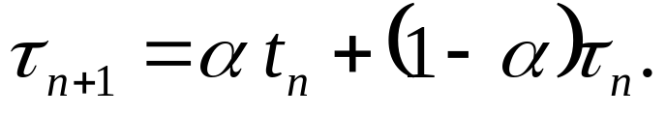
Determining Length of Next CPU Burst
Can only estimate the length
Can be done by using the length of previous CPU bursts, using exponential averaging

Slide 5

Determining Length of Next CPU Burst
=1/2*6+(1-1/2)10
= 8

Slide 6
Shortest Job Next (SJN)/Shortest Job First
Process | Execute/Burst Time | Service Time / Response Time
P0 | 5 | 3
P1 | 3 | 0
P2 | 8 | 14
P3 | 6 | 8

Slide 7
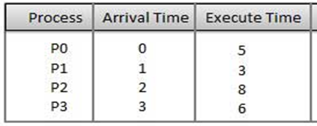
P0
P1
P3
P2
0
5
8
14
22
Average waiting time = ((0-0)+(5-1)+(14-2)+(8-3)) / 4 =21/4= 5.25

Slide 8
Shortest Job Next (SJN)/Shortest Job First
PROCESS | ARRIVAL TIME | BURST TIME
P1 | 0 | 8
P2 | 1 | 5
P3 | 2 | 2
P4 | 3 | 4

Slide 9
Shortest Job Next (SJN)/Shortest Job First
PROCESS | ARRIVAL TIME | BURST TIME
P1 | 0 | 8
P2 | 1 | 5
P3 | 2 | 2
P4 | 3 | 4
P1
P3
P4
P2
0
8
10
14
19
Average waiting time = ((0-0)+(14-1)+(8-2)+(10-3)) / 4 =26/4= 6.5

Slide 10


